Slide 1




DATABASE SYSTEMS · FINAL PROJECT
Movie Rental
OLTP
Data Warehouse Project
ETL
From OLTP Database to Analytical Dashboard
Team:
Abd Al-Rahman remawi · Islam Sead Aldeen
Data Warehouse
Course:
Database Systems — Spring 2026
Instructor:
Dr.Momen Abu Ghazaleh
Date:
June 2026
Dashboard
Notes:
SPEAKER NOTES — SLIDE 1 (Title): Introduce yourself and your team. Say something like: "Today we will present our final project for Database Systems. The topic is building a Data Warehouse for a Movie Rental system. We started with an operational database similar to Sakila, designed a dimensional data model, performed ETL, and built an analytical dashboard." Keep it brief — about 30 seconds.

Slide 2


Project Objective
OLTP — Daily Operations
Data Warehouse — Analysis
Handles day-to-day transactions
Processes rentals, payments, returns
Optimized for INSERT / UPDATE speed
Stores current operational data
Not designed for complex analysis
Aggregates historical data over time
Answers complex business questions
Optimized for fast analytical queries
Supports decision making for managers
Integrates data from multiple sources
2 / 11
Notes:
SPEAKER NOTES — SLIDE 2 (Objective): Say: "The OLTP database, which in our case is based on Sakila, is great for daily operations — recording rentals, payments, and customer data. But it is not efficient when we want to answer business questions like 'what is our best-selling movie category?' or 'how did revenue change over the last year?' That is exactly why we built a Data Warehouse — to convert operational data into analytical insights." Possible instructor question: "Why can't you just run analytical queries on the OLTP database?" Answer: "You can run some queries, but OLTP databases are normalized for fast inserts and updates, not for complex aggregations. Running heavy analytical queries would slow down the operational system, and the data model is not designed for easy reporting."

Slide 3
OLTP vs. Data Warehouse
Dimension | OLTP Database | Data Warehouse
Purpose | Daily transactions | Business analysis & reporting
Data Model | Normalized (3NF) | Dimensional (Star Schema)
Data Scope | Current / real-time | Historical / aggregated
Operations | INSERT / UPDATE / DELETE | SELECT / aggregate queries
Users | Staff, cashiers, clerks | Managers, analysts, BI tools
Performance Goal | Fast individual record access | Fast aggregation of millions of rows
3 / 11
Notes:
SPEAKER NOTES — SLIDE 3 (OLTP vs DW): Walk through the table row by row. Highlight key differences: "Notice that the OLTP uses normalized tables to avoid data duplication, while our Data Warehouse uses a dimensional model — specifically a Star Schema — which is easier for reporting." Also emphasize: "OLTP focuses on the present moment, while the DW stores historical data so we can see trends." Possible instructor question: "What is normalization and why don't we use it in the DW?" Answer: "Normalization is splitting data into many related tables to reduce redundancy. It is great for avoiding anomalies in OLTP. But in a Data Warehouse, we deliberately denormalize to reduce joins and make queries faster."

Slide 4






Business Questions the DW Can Answer
Which movies generate the most revenue?
Which rental categories are most popular?
Which stores and staff perform best?
How does revenue change over time?
Who are our most valuable customers?
What are peak rental periods and seasons?
4 / 11
Notes:
SPEAKER NOTES — SLIDE 4 (Business Questions): Say: "Before designing the data warehouse, we identified the key business questions it needs to answer. These are the questions that managers at a movie rental company would want to ask." Go through each card briefly. Then say: "These questions guided all our design decisions — which fact tables we need, which dimensions to include, and what measures to store." Possible instructor question: "How did business requirements influence your design?" Answer: "Each question maps to specific dimensions and measures. For example, 'revenue over time' requires a Date dimension and a revenue measure in the fact table. 'Store performance' requires a Store dimension."

Slide 5

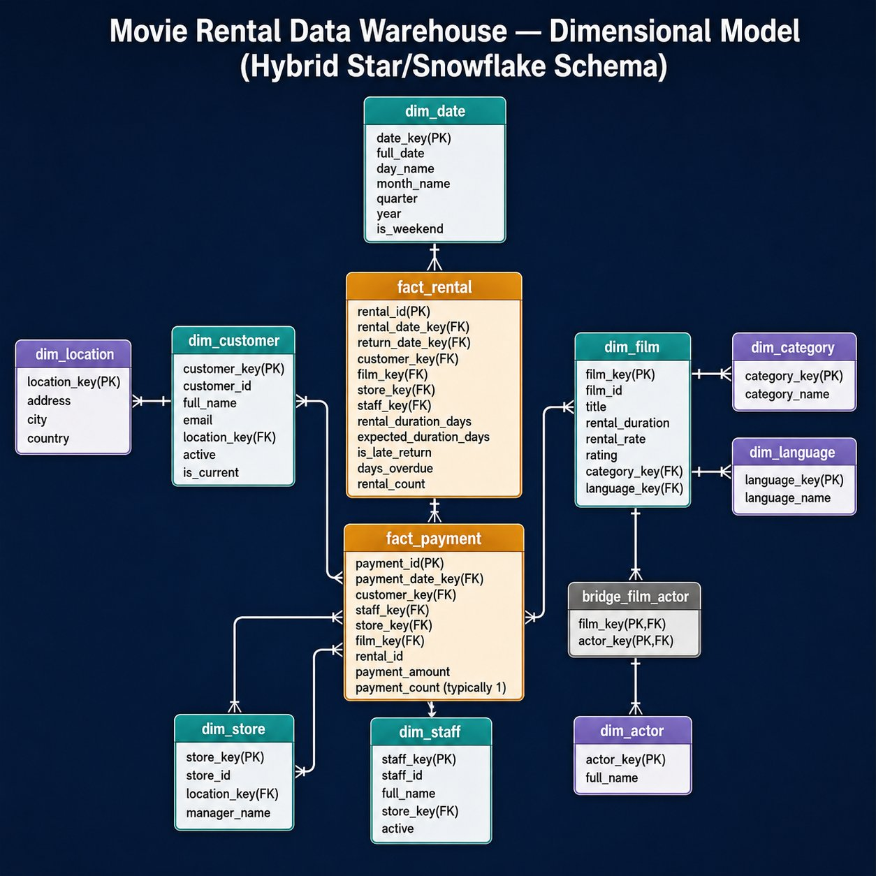
Dimensional Model — Star Schema
Schema Overview
Fact Tables (2)
· fact_rental — grain: one row per rental
· fact_payment — grain: one row per payment
Core Dimensions (5)
· dim_date · dim_customer · dim_film
· dim_store · dim_staff
Sub-Dimensions (3)
· dim_category · dim_language · dim_location
Bridge Table (1)
· bridge_film_actor — resolves film ↔ actor many-to-many
Schema Type
· Hybrid Star / Snowflake Schema — dim_film→category/language · dim_store→location
Grain: One row per rental · One row per payment
5 / 11
Notes:
SPEAKER NOTES — SLIDE 5 (Dimensional Model): Say: "This is our actual dimensional model. It is a Hybrid Star/Snowflake Schema. At the center we have two fact tables — fact_rental and fact_payment. Around them are dimension tables that provide context." Point to the diagram: "The core dimensions are dim_date, dim_customer, dim_film, dim_store, and dim_staff. We also have sub-dimensions: dim_category and dim_language extend dim_film, and dim_location extends dim_store — this is the snowflake part. We also have a bridge table, bridge_film_actor, to handle the many-to-many relationship between films and actors." Then explain grain: "The grain of fact_rental is one row per rental. The grain of fact_payment is one row per payment." Possible instructor question: "What is the grain and why is it important?" Answer: "The grain defines the level of detail in the fact table. Choosing the wrong grain causes wrong aggregations. We chose one row per rental/payment because it is the most atomic event in the system." Possible question: "You said hybrid schema — what does that mean?" Answer: "A pure star schema has all dimensions directly connected to the fact table with no further normalization. A snowflake further normalizes some dimensions. Ours is hybrid because most dimensions are flat (star), but dim_film connects to dim_category and dim_language, and dim_store connects to dim_location — those are the snowflake branches."

Slide 6

ETL Process — Extract, Transform, Load
EXTRACT
TRANSFORM
LOAD
Read from OLTP tables
No changes to source
Tables: rental, payment, film, customer, store, staff, category
Clean & validate data
Handle NULL values
Join related tables
Generate surrogate keys
Derive new fields (e.g. year, month)
Populate dimension tables first
Then load fact table
Use foreign key references
Run data quality checks
OLTP Database → ETL Process → Data Warehouse
6 / 11
Notes:
SPEAKER NOTES — SLIDE 6 (ETL): Say: "ETL stands for Extract, Transform, Load — the process of moving data from the OLTP database into the Data Warehouse." Explain each stage: "First we Extract by reading from the OLTP tables without changing anything. Then we Transform: we clean the data, handle missing values, join tables together, and create surrogate keys. Finally we Load the results into our dimension tables and fact table." Possible instructor question: "What is a surrogate key and why do you need it?" Answer: "A surrogate key is an artificial numeric key we assign in the Data Warehouse — like customer_key = 1, 2, 3... instead of using the original OLTP primary key. This protects the DW from changes in the OLTP system and allows us to track historical changes." Possible question: "What order do you load the tables?" Answer: "Dimensions must be loaded before the fact table because the fact table references dimension keys as foreign keys."

Slide 7

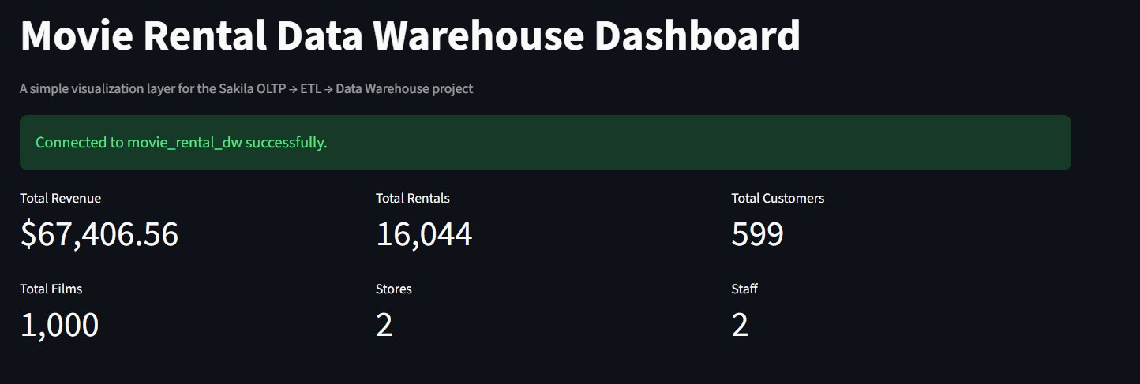
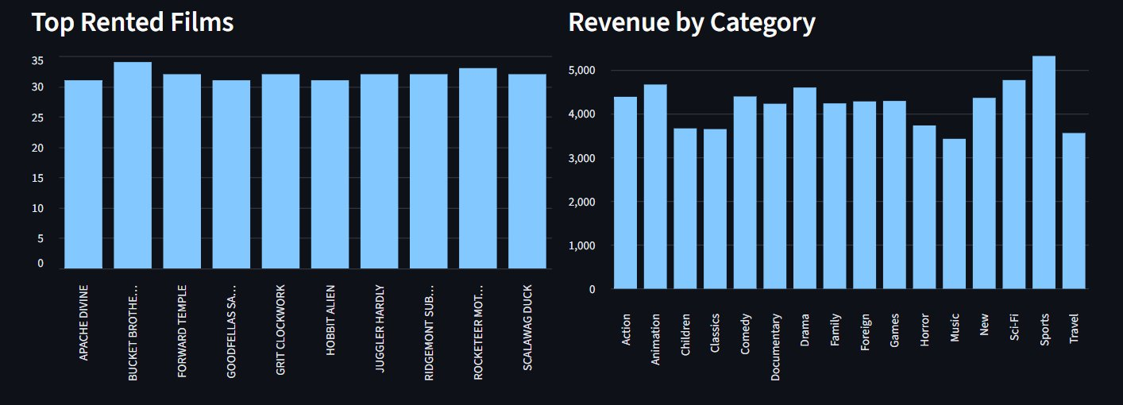
Analytical Dashboard — Results Visualization
Live screenshots from our actual dashboard (connected to movie_rental_dw):
7 / 11
Notes:
SPEAKER NOTES — SLIDE 7 (Dashboard): Say: "These are actual screenshots from our working dashboard, connected live to our Data Warehouse database called movie_rental_dw." Walk through the KPIs: "The warehouse contains data on $67,406 in total revenue, 16,044 rentals, 599 customers, 1,000 films across 2 stores managed by 2 staff." Point to the charts: "On the left we have the top rented films — Bucket Brotherhood leads. On the right we see revenue by category — Sports generates the highest revenue, followed by Sci-Fi." Then say: "All of these numbers come directly from SQL queries on the fact and dimension tables in the warehouse." Possible instructor question: "What technology did you use for the dashboard?" Answer: "We built a web-based dashboard that connects to our PostgreSQL/MySQL Data Warehouse using [your actual tech]. The charts are generated by querying the fact and dimension tables using GROUP BY aggregations." Possible question: "What is the most interesting insight from your data?" Answer: "Sports has the highest revenue despite not being the most obvious category — this kind of unexpected insight is exactly what a Data Warehouse helps you discover."

Slide 8

Results & Business Insights
Movie Performance
Customer Behavior
Top films like Bucket Brotherhood identified by rental count. Sports & Sci-Fi lead revenue by category.
599 active customers tracked. High-value customers identified by total spending across 16,044 rentals.
Store Performance
Revenue Insights
Revenue and rental volume measurable per store across 2 locations, supporting management evaluation.
$67,406 total revenue stored and queryable. Trends, peaks, and category breakdowns available for planning.
8 / 11
Notes:
SPEAKER NOTES — SLIDE 8 (Results): Say: "After building the Data Warehouse and connecting the dashboard, we are able to provide real business insights. For example, we can see which movie categories generate the most revenue, which customers are the most loyal, how each store is performing, and whether revenue is growing or declining over time." Then say: "All of this was impossible to get efficiently from the OLTP database alone." Possible instructor question: "What is the most valuable insight your DW provides?" Answer: "We believe identifying top-performing movies and categories is most valuable, because this directly helps managers decide which films to stock more of."

Slide 9

Project Challenges
1
Understanding the OLTP Schema
Mapping all 16 Sakila tables and understanding their relationships before designing the DW.
2
Choosing the Right Grain
Deciding whether the fact table should be at the payment or rental level required careful analysis.
3
ETL Transformations
Handling NULL values, generating surrogate keys, and joining multiple tables without errors.
4
Dimension Design
Deciding which attributes belong in dimensions vs. fact, and handling slowly changing dimensions.
5
Dashboard Integration
Connecting the frontend to the warehouse database and making queries efficient enough for real-time display.
9 / 11
Notes:
SPEAKER NOTES — SLIDE 9 (Challenges): Be honest and specific here. Say: "Like any real project, we faced several challenges." Go through each one briefly. The most important ones to explain well are the grain challenge and the ETL challenge. Possible instructor question: "What was your biggest technical challenge?" Answer: "The ETL transformations were the hardest part. We had to carefully join the rental, payment, film, and customer tables in the right order, generate surrogate keys correctly, and handle cases where payments were missing or rentals had no return date." Possible question: "Did you face any data quality issues?" Answer: "Yes — the Sakila database has a few rental records without return dates, and we had to decide whether to exclude them or set a default return date. We chose to exclude incomplete records from the fact table."

Slide 10

Conclusion
→
→
→
OLTP
Database
ETL
Process
Data
Warehouse
Dashboard
& Analysis
Sakila-like source
Extract · Transform · Load
Star Schema model
Visual insights
Successfully designed a Hybrid Star/Snowflake dimensional model with 2 fact tables, 5 core dimension tables, 3 sub-dimension tables, and 1 bridge table.
Implemented a complete ETL pipeline to transform Sakila OLTP data into the warehouse
Built an analytical dashboard answering 6 key business questions for movie rental management
The project demonstrates a complete, real-world Business Intelligence workflow
Thank you for your attention — Ready for questions
10 / 11
Notes:
SPEAKER NOTES — SLIDE 10 (Conclusion): Say: "To summarize — we started with a normalized OLTP database based on Sakila, analyzed the schema, designed a Star Schema dimensional model, implemented ETL to populate the warehouse, and built a dashboard to visualize the results. This complete BI pipeline allows business managers to make better data-driven decisions." End with: "We are now ready for your questions." Possible instructor question: "If you had more time, how would you improve the project?" Answer: "We would implement Slowly Changing Dimensions to track historical changes in customer or film data. We would also add more KPIs, optimize ETL performance using incremental loading, and add user authentication to the dashboard."

